Slide 1
Adding real-world GIS and census data to agent-based modelling for social scientists
The webinar will begin at 3pm
You now have a menu in the top right corner of your screen.
The red button with a white arrow allows you to expand and contract the webinar menu, in which you can write questions/comments.
Feel free to type questions as we go, we will answer as many as we can at the end
We can’t hear you.
Notes:
Hello everyone.
The webinar starts in 5 minutes.
Hopefully you can all hear me –you are on mute and will stay on mute throughout.
If you want to ask a question you can do so at any time by typing into the questions box at the top right of your screen – press the red arrow if you can’t see it.

Slide 2

Adding real-world GIS and census data to agent-based modelling for social scientists
Dr. J. Kasmire
UK Data Service
30 January 2020
Notes:
Thank you for joining us today.
My name is Dr. Julia Kasmire and today I am presenting a New Forms of Data Training on behalf of the UK Data services. Today’s webinar is called “Adding real-world GIS and Census data to agent-based modelling for social scientists”.
That is quite a mouthful, so thanks for being brave and joining me today.
Before we get into the content today, I just want to double check if you can hear me properly.

Slide 3
Can you hear us?
?
Notes:
You should see a poll on your screen around about now.
Please respond to the poll to let us know whether you can hear us or not…
Yes
No

Slide 4
Can you hear us?
If not:
Check your volume, and that your speaker/headset is plugged in
Click on audio to change to listening via phone.
We are recording this webinar – we plan to put it on our website
Notes:
Great! The poll results are in.
This slide for anyone that cannot hear us. It just offers a few suggestions for dealing with audio problems.
I’ll just leave this slide up for a moment…
Moving on!

Slide 5
ABM for social scientists – webinar series
ABM: An Intro
– Jan 16, 2020, recording available
ABM: Adding Data
– Jan 30, 2020
ABM: Experiments and Output
– Feb 13, 2020
Notes:
Today’s webinar is the second in a series of three, all on the topic of agent-based modelling for social scientists.
The first webinar introduced the theory and basic concepts of agent-based modelling for social scientists. A recording of that webinar is already available to view on the UKDS youtube channel. The third webinar will cover how to set up and run parameter sweeps and experiments. It will also address what to do with the output of those agent-based modelling experiments.
If you have not already done so, you can sign up to attend the third through the UKDS events page.

Slide 6
Table of Contents
Opening models in Netlogo – Model Library, Code Examples and .nlogo files
Set up and run a random "Tram commute model"
Download and prepare real-world GIS and census data files
Import Greater Manchester shapefiles into code and load them into the model
What else could I do with this?
Summary
Questions
Notes:
To give you an overview of today’s topics.
CLICK
I begin by demonstrating several ways to open models in NetLogo.
CLICK
Then I set up and run a custom-built "Tram commute model“ using randomly generated data.
CLICK
Next, I show you where I downloaded some real-word data and how I prepared it for loading into my Tram Commute Model.
CLICK
After that, I show you how to import the prepared real-world data into the same Tram Commute Model. I also show you what it looks like when loaded with real-world data instead of randomly generated data.
CLICK
Then I talk a bit about how you might use a model like this to address different social science research questions.
CLICK
I conclude with a summary of everything I have demonstrated today in the webinar.
CLICK Of course, after the demonstration portion of the webinar ends, there is some time for you to ask me some questions.
If everyone is ready, then let’s get started!

Slide 7
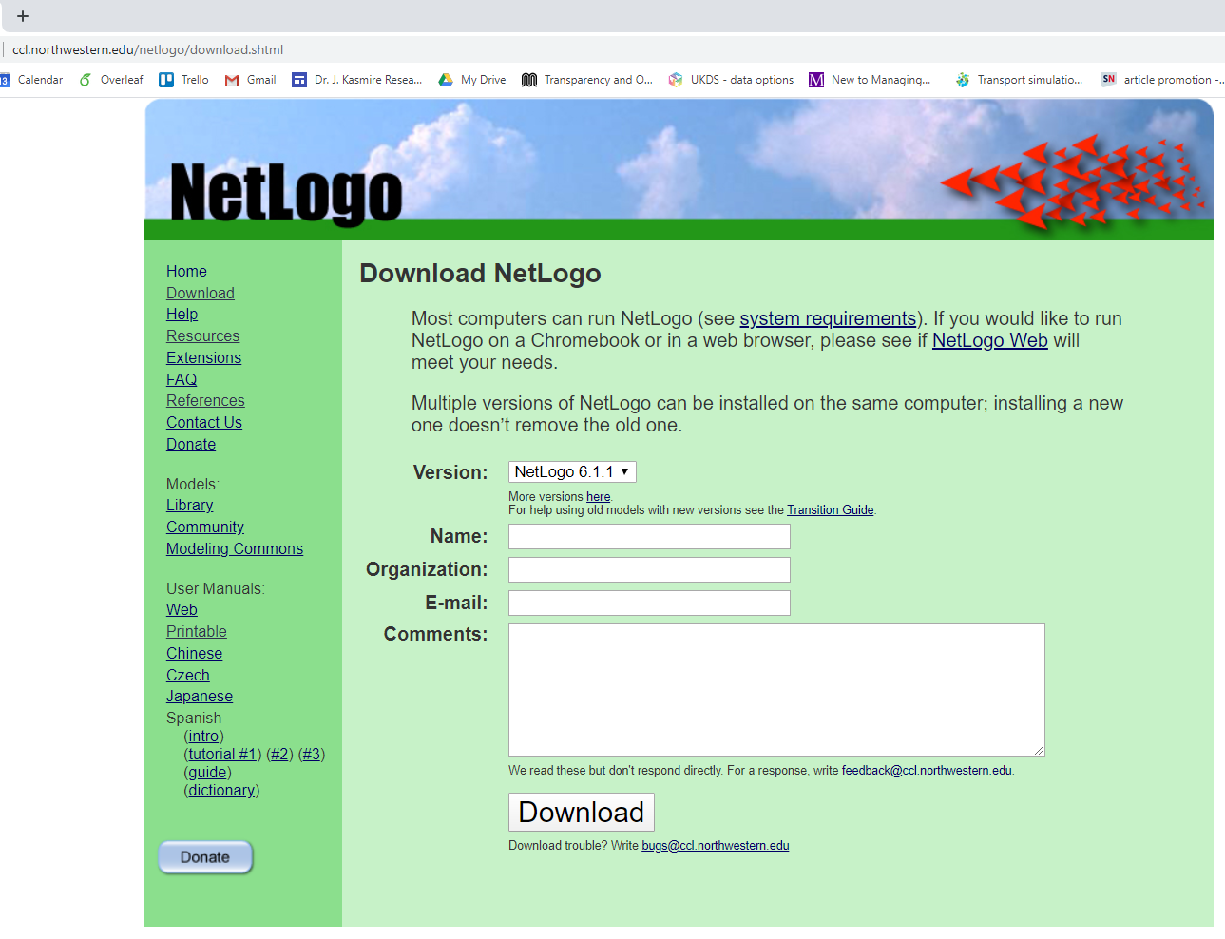
Download NetLogo
Notes:
If you haven’t already done so,
CLICK
You can go to Northwestern University’s webpage to
CLICK
Download NetLogo, which is free and is available for all major platforms.
NetLogo is also a small programme, so it downloads quickly.

Slide 8
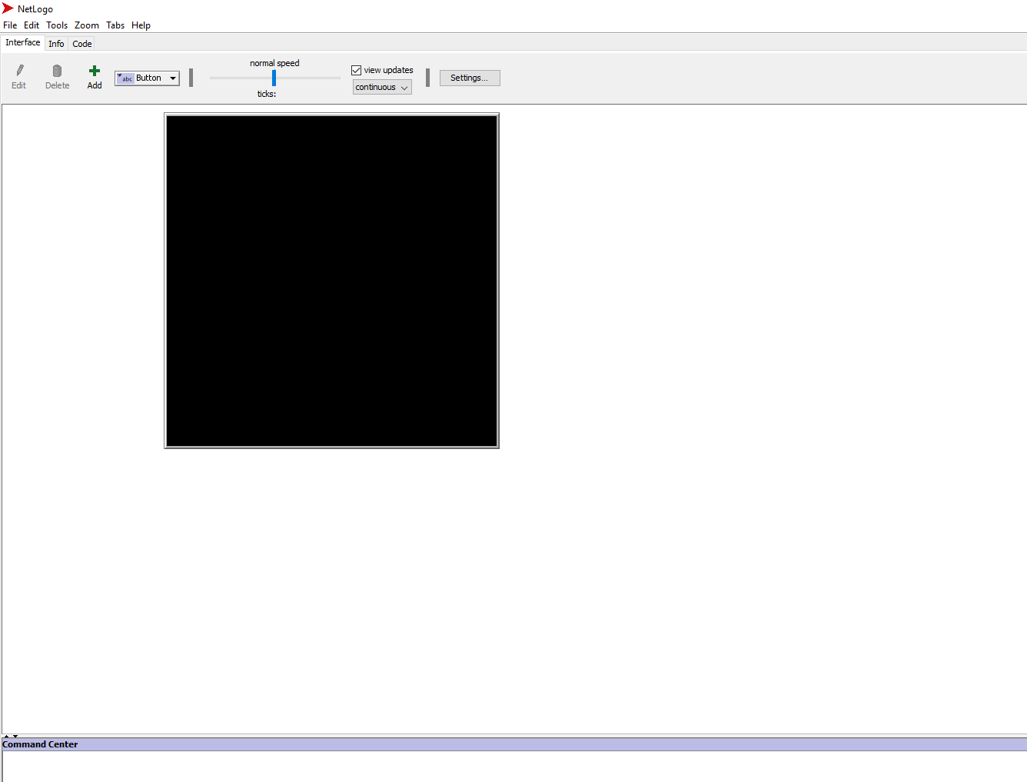
NetLogo opening view
Notes:
When you first open NetLogo,
CLICK
You will see the interface tab of a new and blank model.
CLICK
You can start adding to this blank model right away, either by adding buttons, sliders and the like from the interface tab.
CLICK
You can also go over to the code tab to start writing code in the blank model.

Slide 9
Open a NetLogo model
Notes:
But most of the time you will want to open a model that already exists rather than starting from a blank slate every time.
To do that,
CLICK
Go to the File menu on the top left of the window.

Slide 10
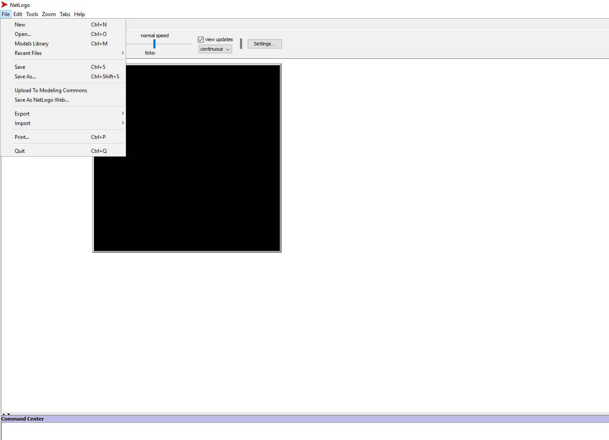
File -> Models Library
Notes:
Within the File menu, you will see several options for ways to open existing models.
CLICK
First, I want to show you the Models Library.

Slide 11
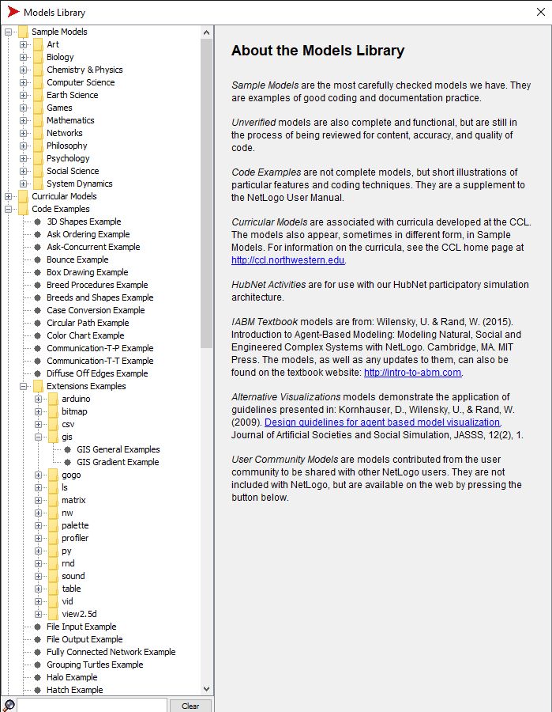
Models Library: demonstrate concepts, code, extensions
Notes:
The models library is built into NetLogo and it includes a large number of
CLICK
Sample models. These models were built to address a wide variety of research questions, which you can see range from art, hard sciences, and mathmatics to philosophy, psychology and social sciences.
CLICK
The models library also has code examples, which are models that demonstrate well-written code to do various things. Unlike the sample models above, these models don’t address research questions, but they do demonstrate how to do popular and useful things in NetLogo.
CLICK
Of particular interest to us, there are code examples for the various NetLogo Extensions, including the GIS extension that we focus on today.

Slide 12
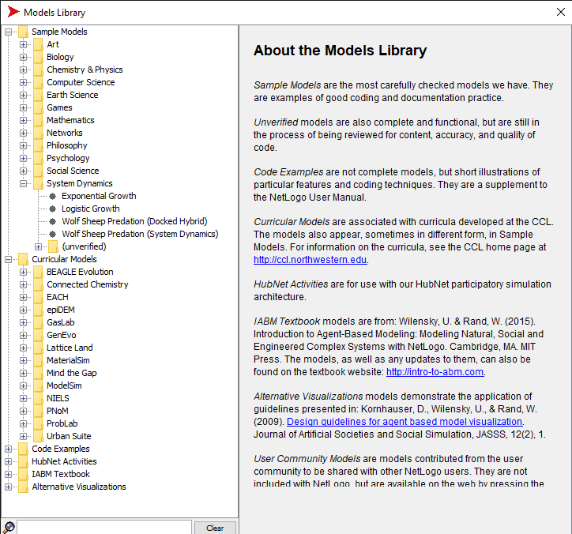
Models Library: so many option
Notes:
Just a bit more about the models library, because it is an absolute treasure trove of resources.
CLICK
Within most of the sample model categories, there is a subfolder of unverified models. These are models that work and have had preliminary checks run on them, but are still undergoing rigorous testing.
CLICK
Then, there is an online course that I believe anyone can join, and set of models that go along with that.
CLICK
There are also models to accompany some participatory systems, and two books about agent-based modelling.
CLICK
You can also search through the models library using this search bar. And finally, although I could not get the screen capture to include it,
CLICK
Underneath the search bar is a link to an online community of user created and submitted models where you can find many many more examples of how researchers have used NetLogo.
I ABSOLUTELY recommend that you browse through the model library, both for the sample models and the code examples. You can mess around with the models, change code, whatever you like. You CANNOT break them so feel free to just have a play.

Slide 13
Open an existing NetLogo model
Notes:
However, most of the time, you probably want to work on a model that you saved previously or that you have downloaded from someone else.
CLICK
For this one, you go to File again …

Slide 14
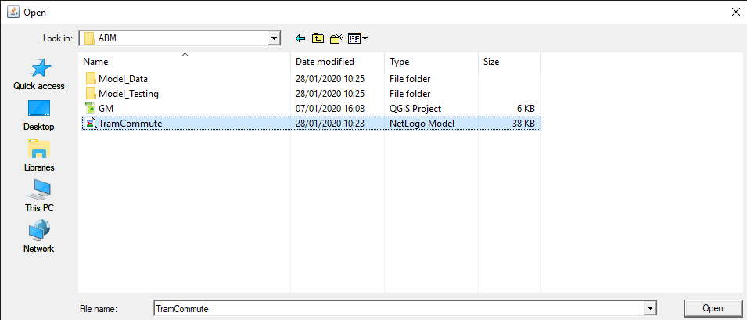
File -> Open -> Navigate to TramCommute.nlogo
Notes:
But instead of going to Models Library, you go to
CLICK
Open
CLICK
And then navigate to where you have a saved NetLogo model.

Slide 15
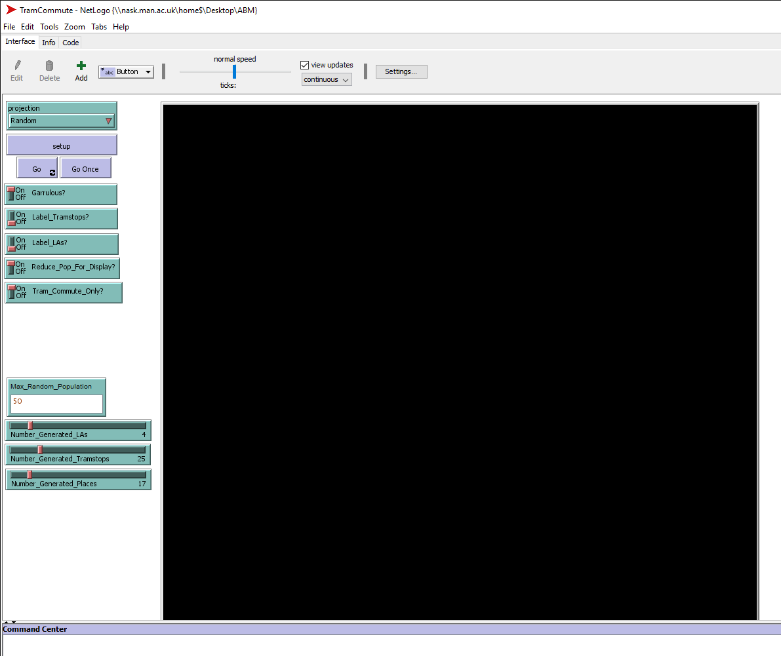
Setup a random "Tram Commute Model"
Notes:
Now that it is open, I need to set up my saved Tram Commute Model. This model simulates a cross-local authority region that has a tram network, places to live, places to go and commuters that move between those places.
CLICK
First, I select Random projection. This tells the model that I want it to create a commuter region without any external input from maps.
CLICK
Then, I decide on whether I want all of these switches to be on or off. I turn several off to improve way the model is displayed, but don’t worry too much about these for right now.
CLICK
Next, I set a few modeller input features. For example, I can decide on how many local authorities I want in my randomly generated commuter region. I can also decide on the approximate maximum number of commuters that I want in each of those local authorities. I can decide on how many tram stops I want in the total tram network and how many places for the commuters to go.
CLICK
Finally, I hit Setup. This tells the model to generates a metropolitan area and tram network according to the settings I have selected.

Slide 16
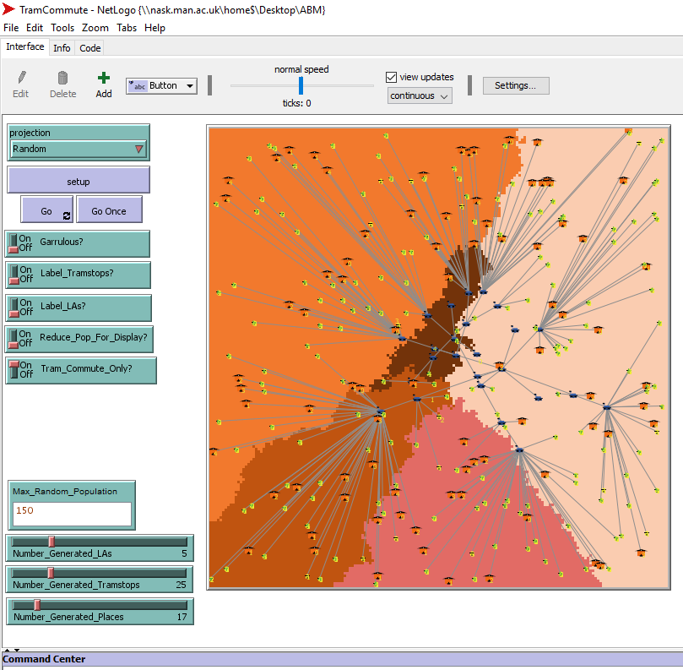
A random "Tram Commute Model" when setup
Notes:
Here is what the randomly generated tram commute area looks like.
CLICK
Each colour represents a different local authority, created according to the decisions I made prior to hitting Setup.
In this model, I decided to have each local authority change its colour to reflect its relative total population.
Not only does this makes it easier to see where one local authority ends and the next begins,
CLICK
It also shows whether local authorities are more or less similar in terms of population.
For example, the two local authorities on either side of this border are both shades of orange so they have populations that are more similar to each other than they are to the other local authorities in this randomly generate metropolitan region.
In NetLogo, you can inspect individual agents by right clicking on them.

Slide 17
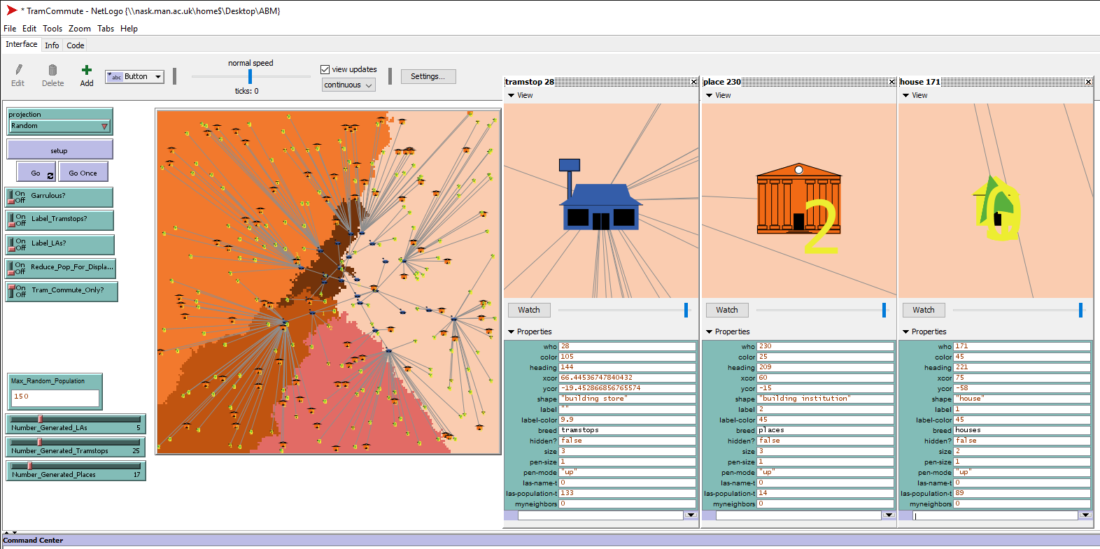
A random "Tram Commute Model" when setup
Notes:
This Tram Commute model has agents representing all of the buildings as well as the commuters, so in this screen you can see a close up inspection of the different buildings.
CLICK
The blue buildings are tram stops. The number of these is directly determined by the modeller input slider.
CLICK
The orange buildings are destinations that commuters might want to go to. These could represent work places, shopping centres, museums, traffic court, whatever you want them to be. As this is a fairly generic model created for a proof of concept only, there is only a single, generic “place” that commuters might go.
CLICK
The yellow ones are houses. The image of this is less clear because the commuters are sitting on top of the. Commuters are shaped like green arrows so that you can see which way they are facing. This one, for example, is ready to head out of its house because it is facing down the link to the nearest tram stop.
CLICK The number of houses and commuters are determined by the maximum random population per local authority number here on the left, but not in a one-to one manner because there is some randomness built into the model. There can be fewer than this number of commuters in each local authority and there are often several commuters per house.

Slide 18
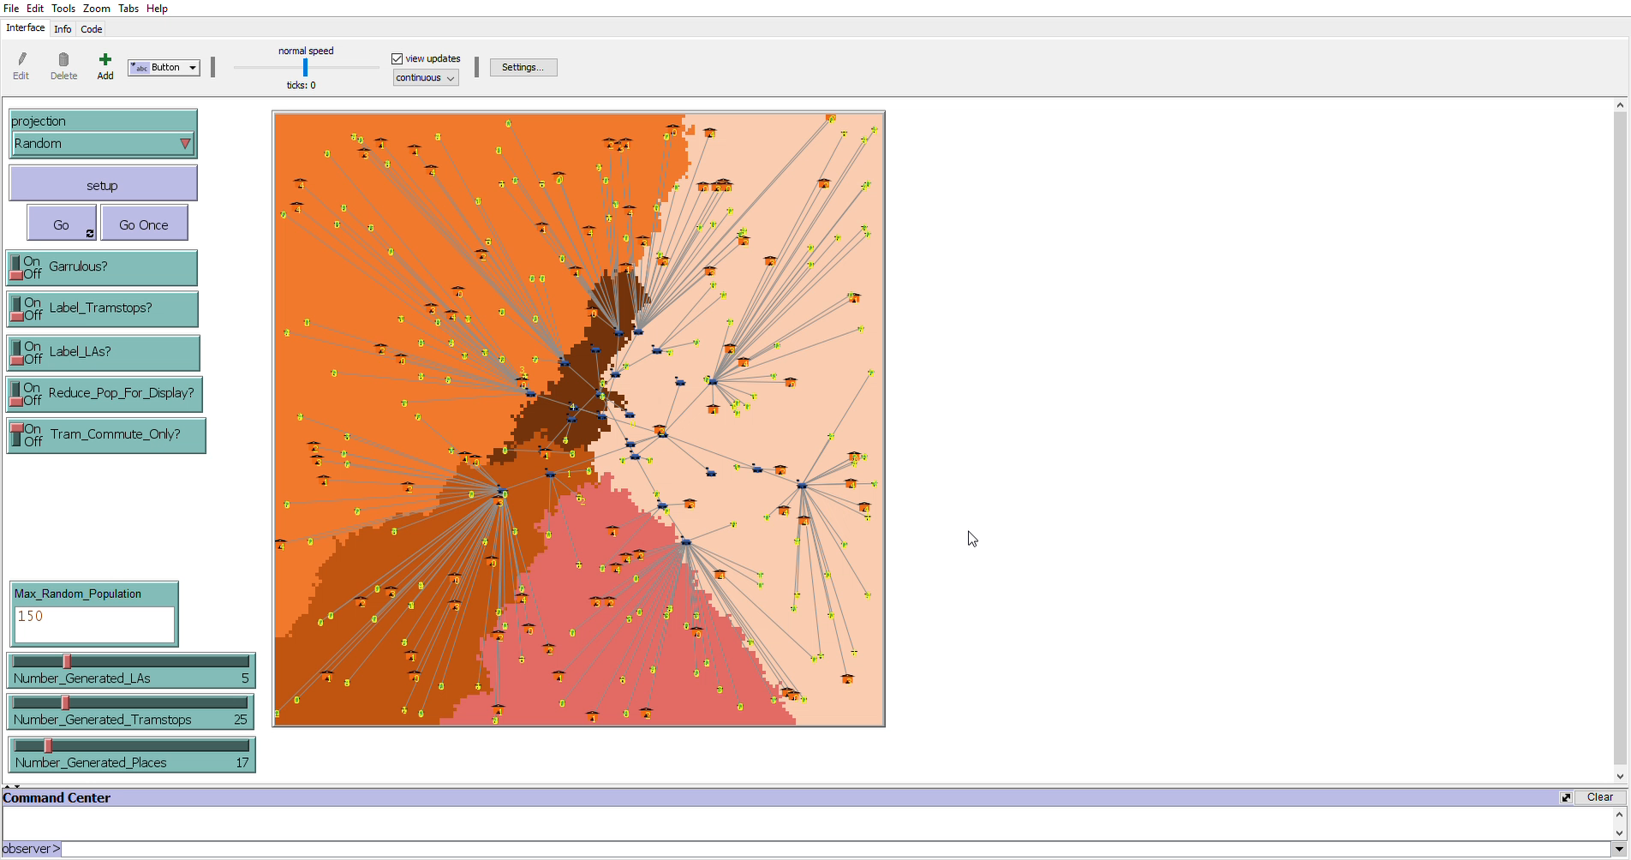
Running the random "Tram Commute Model"
Notes:
To give you an idea of what happens in this model, commuters start out at their houses. They select a place to go to, identify the path to get there, and start moving along the links. They will move more rapidly when they are on a link between two tram stops than when they are on a link from a house or place to a tram stop.
Here is a short video demonstrating what happens when the model runs.
First, I click “Go once” a few times so that you can see their movement in slow motion.
The little arrow-shaped commuters leave their houses, move along the tram network and to their destinations.
When they arrive where they were going, they pick a new destination and go there. The new destination might be their home, so you can see some of them heading to houses and then back out again.

Slide 19
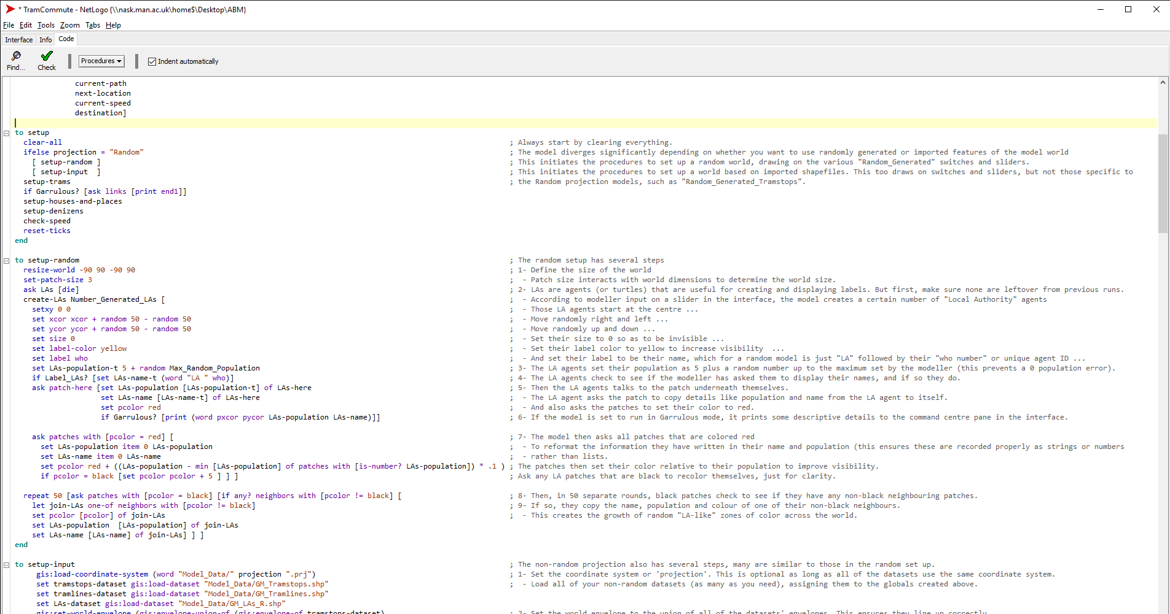
Create Random Setup
Notes:
Here is the code behind the random set up. I won’t spend too much time on this, but I did want to show it to you so you can see the logic.
CLICK
First, the model checks to see what the “projection” is set to. This determines whether or not to execute the random setup code or the imported shape file setup code.
CLICK
I also want to quickly point out that I have spent quite a lot of time commenting on the code for this model. I have not yet made this model code available to you because I want to use it in the next webinar as well. But when it is posted you will be able to read the comments to see how the model works and how the different code blocks fit together.
CLICK
This wraps up everything I want to show you about the Random Tram Commute model. Next, we move on to the same model but with real-world data.

Slide 20
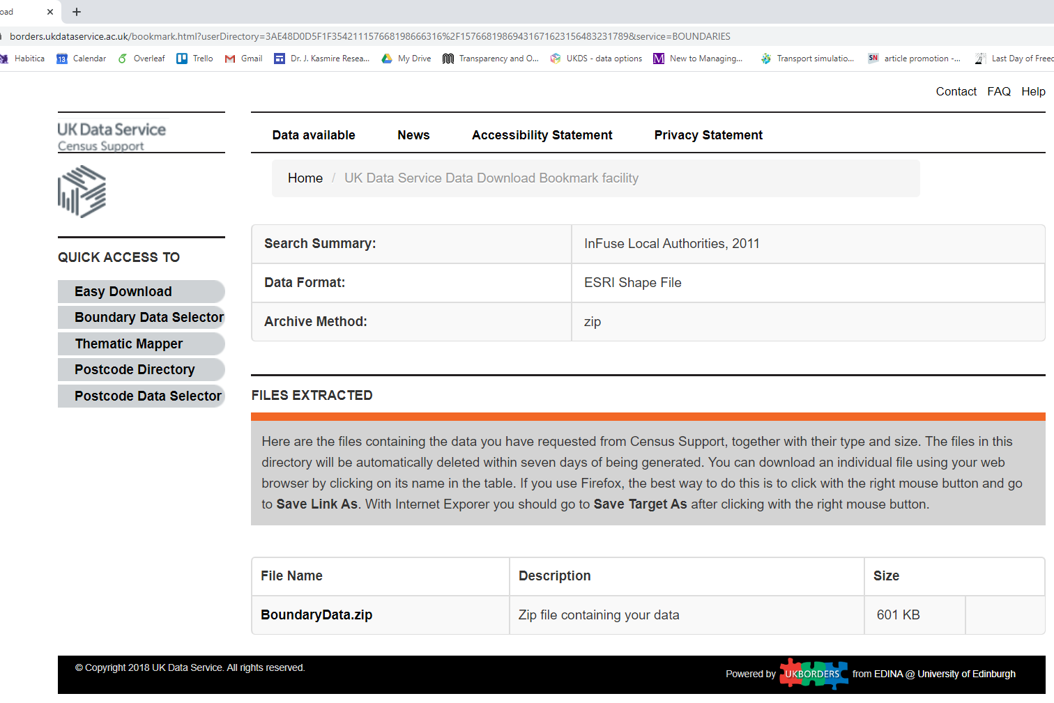
Download Boundary Data – Local Authority shapes
https://tinyurl.com/tek2xhs
Notes:
The first step is to acquire real-world data. The UK data service has a lot of data, including
CLICK
boundary data in shape file format. For the Tram Commute Model, I chose to use a subset of
CLICK
Local Authority boundaries from 2011. Specifically, I chose to get 10 big shapes representing the 10 local authorities that make up Greater Manchester.
I could have chosen Liverpool if I wanted to look at the MerseyRail Network, or London if I want to look at the tube maps. But since I am in Manchester, I figured I would go with what I know.
If you want the exact files I used, you can go to this url
CLICK
Or this tinyurl.
Of course, you might prefer different boundaries.

Slide 21
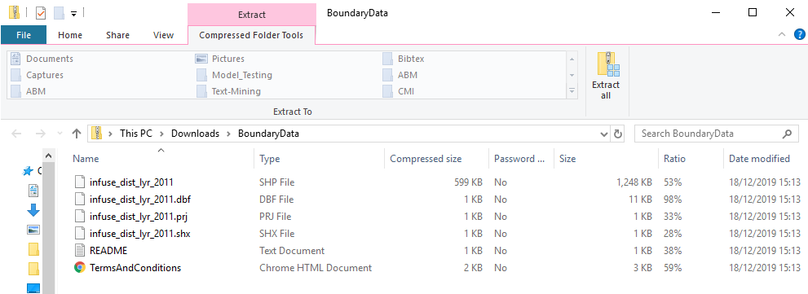
Extract LA Boundary Data
Notes:
Boundary data from the UK data service comes in a zip file that contains
CLICK
a shape file, a projection file and more. These files contain details about the polygon shapes that make up the local authority boundaries.
CLICK
You will need to extract all of them. I recommend that you extract them to the folder where you keep your model, or at least to a nearby folder so that your model can access the files.
We also need files from other sources.

Slide 22
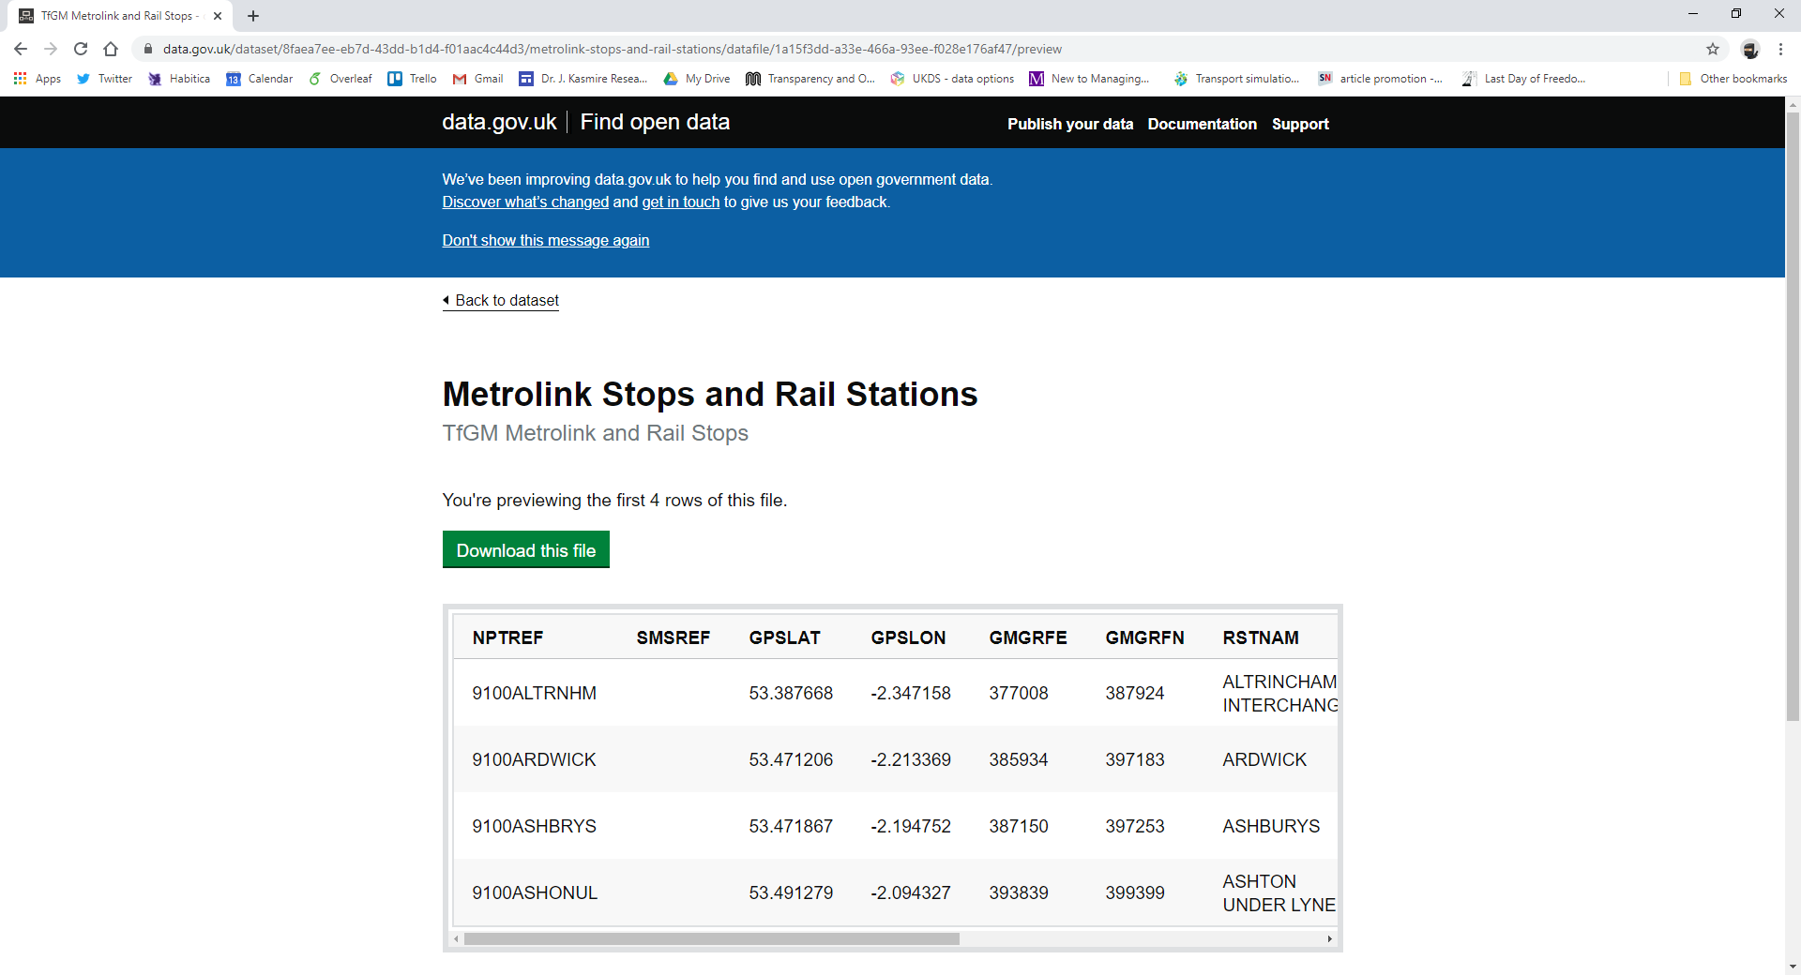
Download GIS Location Data – Metrolink stops
Notes:
For example, we need point data for the location of Metrolink stations.
CLICK
For that, I had to go to data.gov.uk and
CLICK
Downloaded a Comma Separated Value file created by Transport for Greater Manchester. This file has a row for each metrolink and rail stations in the GM area.
CLICK Importantly, this .CSV has “easting” and “northing” references for each station.
These are geographic references that allow the location of stations to be laid over the top of the local authority polygon shapes.

Slide 23
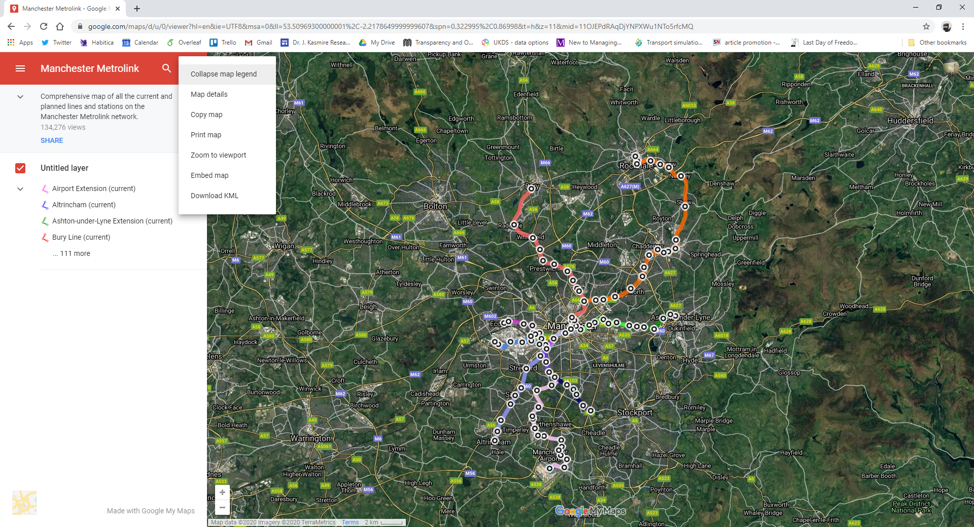
Download GIS Network Data – Metrolink lines
Notes:
We also need a file with geographic references for the lines so that we know which stations are connected to each other.
CLICK
I found a google map of all the current and under construction Manchester Metrolink lines.
CLICK
From here, you can download a Keyhole Markup Language file.
Like the .CSV from before, this .KML file contains the easting and northing references that allow all of our different files to play nicely together.

Slide 24
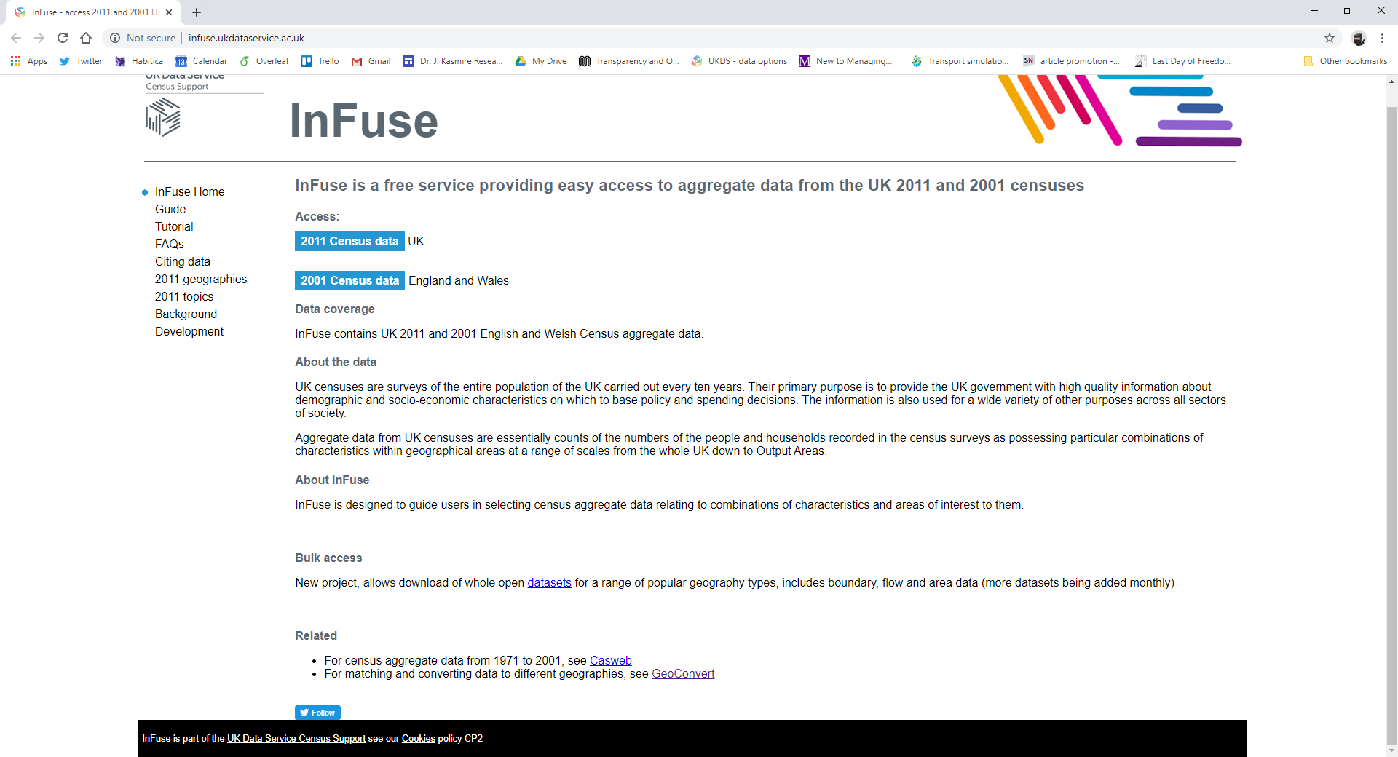
Download Census Data - population
Notes:
Finally, I wanted the number of residents in each local authority to be based on real-world data, so I went to
CLICK
UK Data services InFuse site to download
CLICK
2011 census data. I won’t show you all the steps involved in selecting and downloading census data, but you can access a lot of very useful data directly from here.

Slide 25
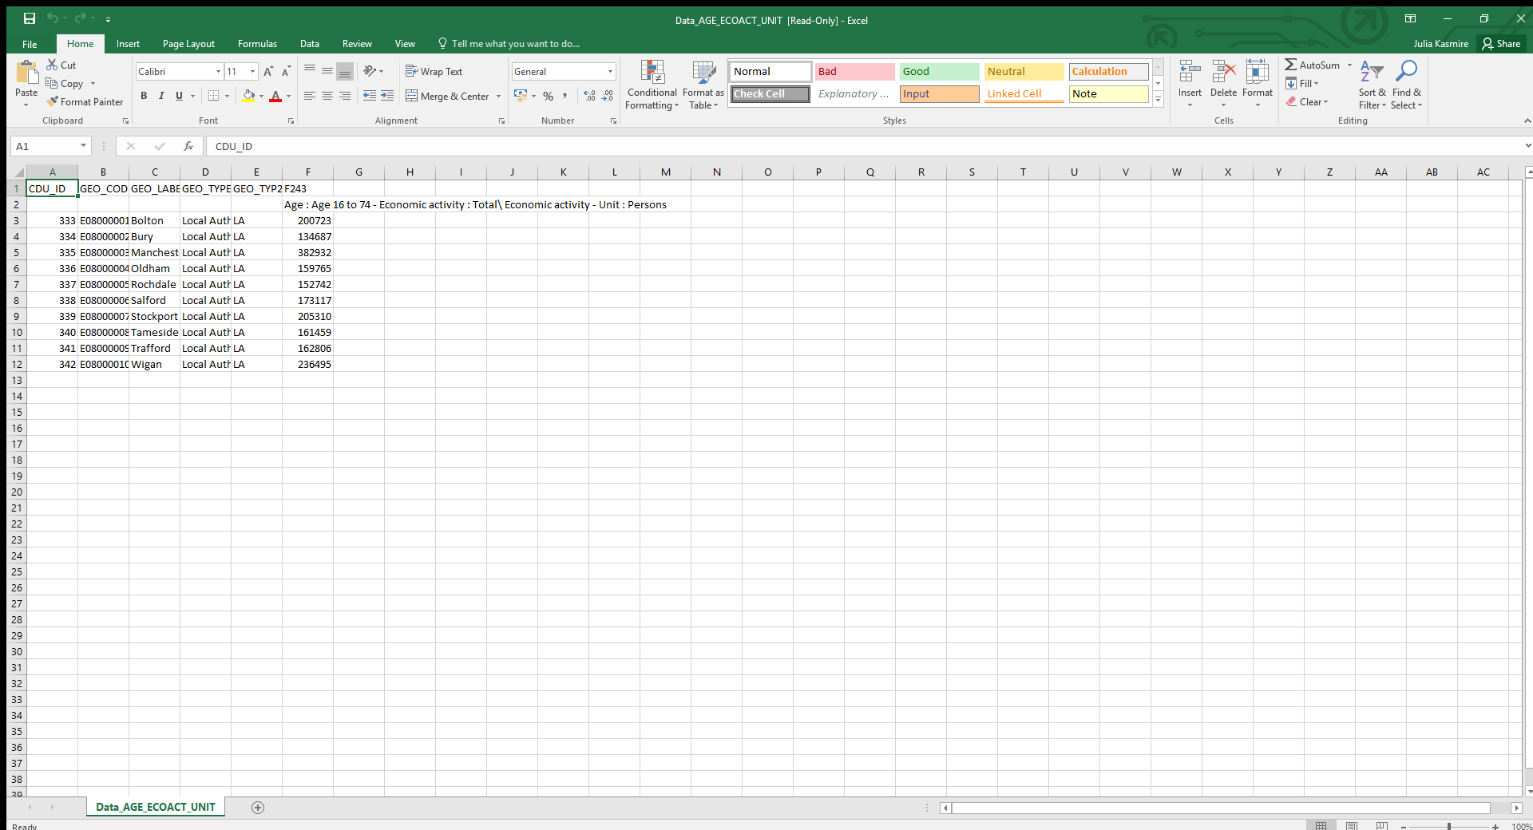
Viewing Census Data - population
Notes:
The files you get from the UK Data Service won’t all look like this one. I wanted a really simple set of data to make it easy to demonstrate how to add data to agent-based models. All I really wanted was
CLICK
The number of economically active persons
CLICK
resident in each local authority.
Now, we have a lot of very cool files, but they are in a lot of different formats.
I have a shape file from the UKDS boundary data selector, a .CSV file from data.gov.uk, a .KML file from the online maps and an Excel file from the UKDS census data portal. If I am going to get all of these different forms of real-world data into NetLogo, I need to consolidate and reformat.

Slide 26
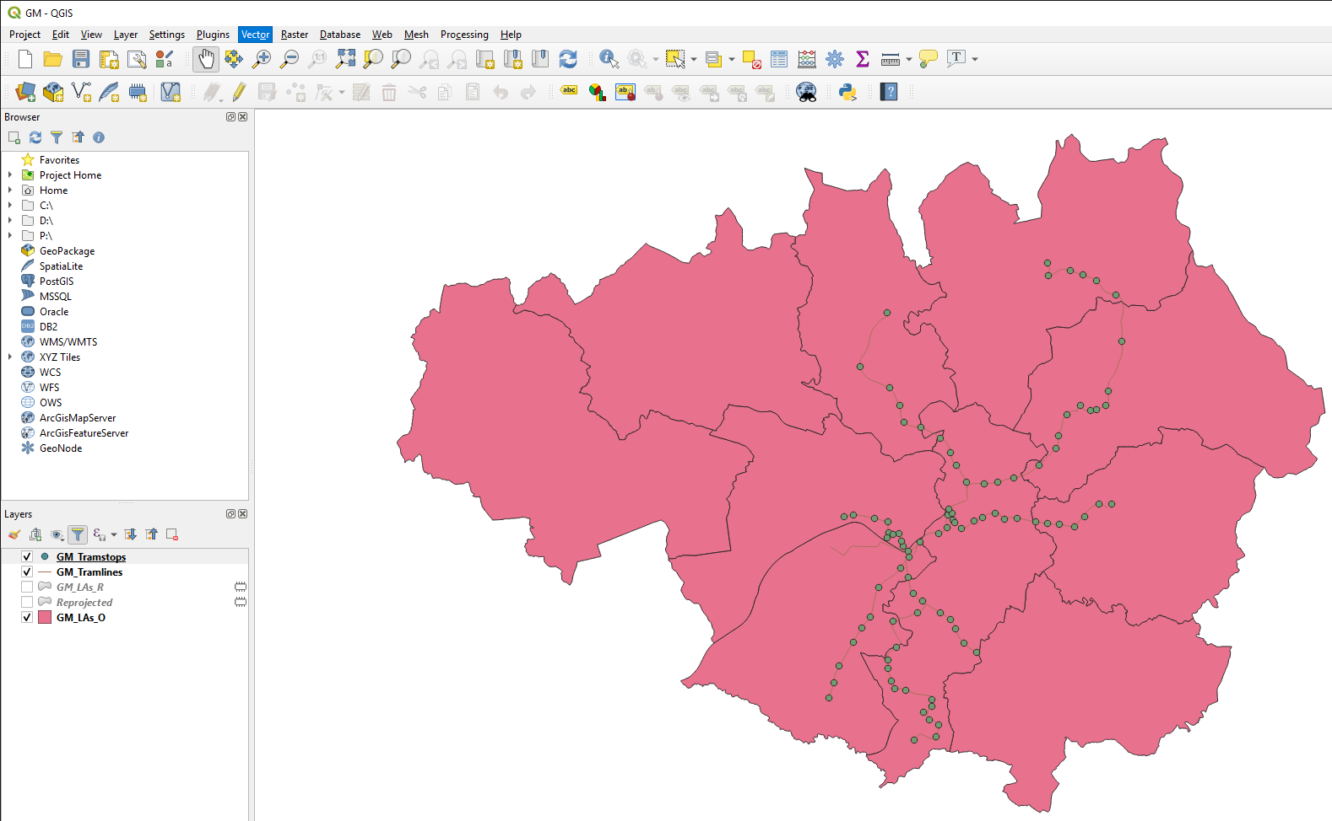
Consolidate GIS and Census Data
Notes:
I did that in
CLICK
Q-G-I-S, or QGIS, which is a mapping program. There are lots of other options if you don’t have or can’t get QGIS. I won’t show you all the steps I followed in QGIS because you might use a different programme or a different version of QGIS and I think it would be more confusing than enlightening to see the details of a process you can’t follow.
But the long and short of it is that will need to load the various downloaded geographic files as
CLICK
layers into a GIS project. The shape file from the UKDS boundary data selector is easy because shape file is a native format in mapping software. But as long as .CSV or .KML files have the easting and northing columns, you can import those two. You just have to tell your mapping software which columns of the .CSV or .KML file are easting and northing.
Once you have them imported as layers, you can edit them as needed. For example, I filtered out the rail stops from the point data file so that I only had stations with a metrolink stop.

Slide 27
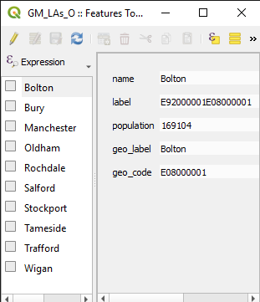
Consolidate GIS and Census Data
Notes:
Next, I wanted to import the population data. Since population data was defined by local authority, I need to add it to the local authority polygon layer.
CLICK
I open up the features of that layer, add a new feature for “population”, and copy over the population values for each local authority. Now, I have made changes to a few of the layers. I removed rail stations from the point data layer and I added populations to the polygon layer. Now, I want to save these adjusted layers so that I can export them into NetLogo.
CLICK
In QGIS, I do this through the vector tab, but any mapping software will have the option to save your changes and export the results in standard formats.
My exported files includes one projection file which provides a coherent overview of how the various geographic references line up
And one shape file for each layer containing the actual things I want to draw in NetLogo. This means I have converted the .CSV and .KML files into shape files as well as saving the changes that I wanted to make.
Next up is importing the projection file and the shape files into NetLogo.

Slide 28
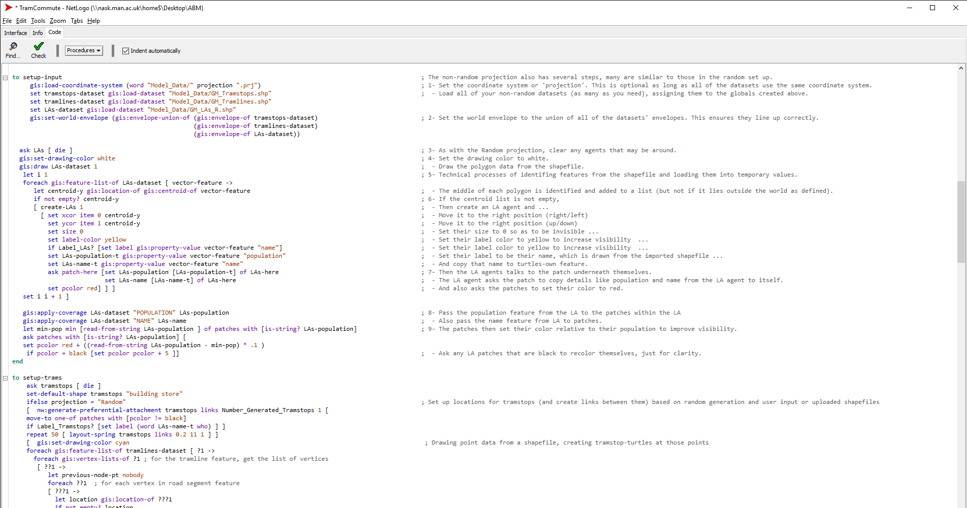
Import Greater Manchester Shapefiles
Notes:
For that, we go back to the model code! This time, we look at what happens if the projection drop-down from the interface tab is NOT set to random.
CLICK
Instead of executing the code for a random setup, it executes the code for a setup using imported files. This begins by
CLICK Loading the projection file. This step sets the size of the world that the agents move around in and ensures that all of the shape files line up properly in that world.
CLICK
Then the model loads the various shape files – one filled with polygons for the local authorities, one with points for the tram stops and one with lines for the tramlines.
CLICK
Following that, there are lots of steps in which the model looks at the imported data, creates agents from that data to represent things like local authorities. The model code then asks those agents to do things like draw lines, save values into features, change colour and more.
This is actually not as complicated as it might seem. Most of this is adapted directly from the GIS extension example that I pointed out earlier when we were looking at the Models Library.

Slide 29
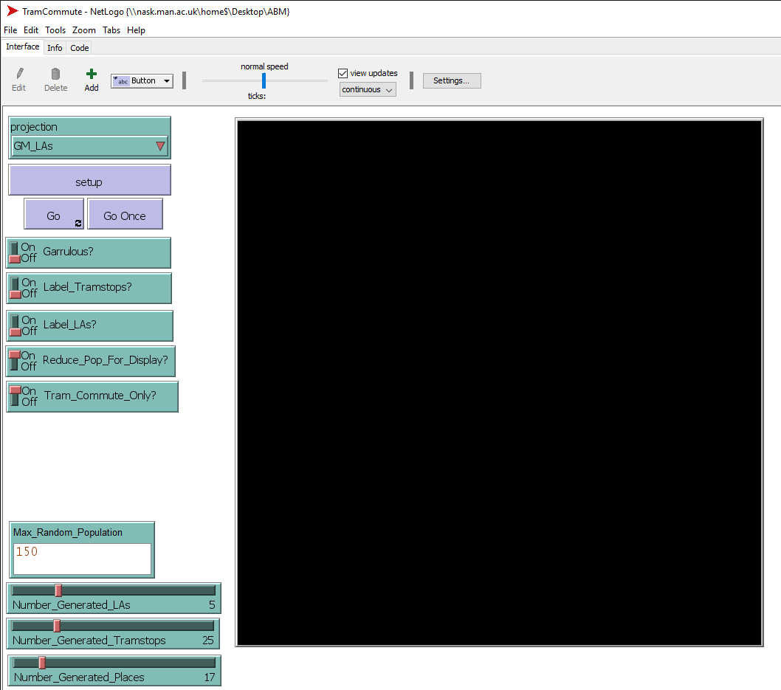
Import Greater Manchester Shapefiles
Notes:
You may or may not find that code to be complicated. But when we go back to the interface, you can select
CLICK
GM_LAs from the projection drop-down and
CLICK
hit “set up” to load the Tram Commute Model with the real-world data files that you prepared.

Slide 30
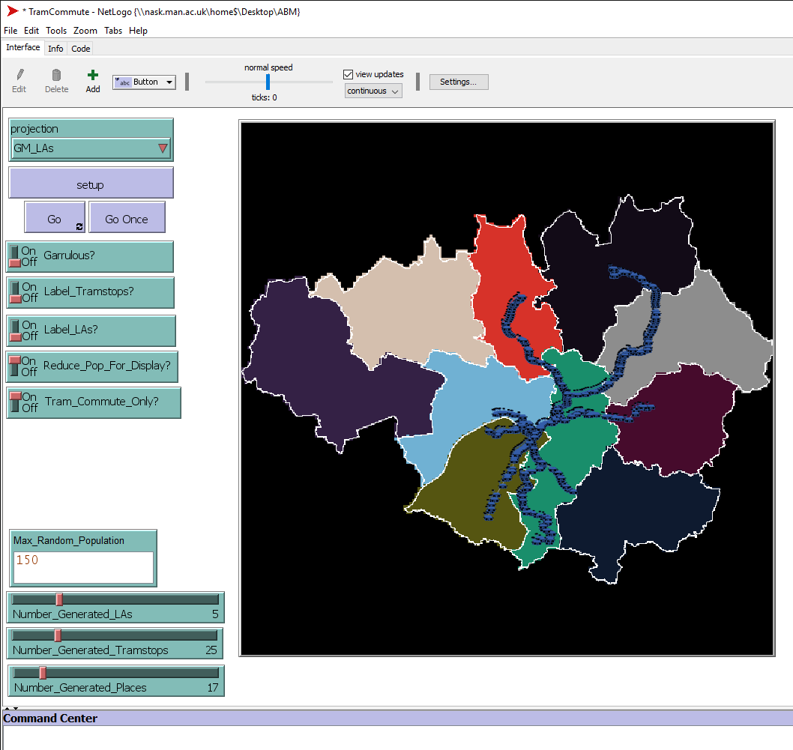
Import Greater Manchester Shapefiles
Notes:
First, you can see that the world includes a map of the 10 local authorities.
CLICK
For example, this one is Bolton.
Again, the local authorities are coloured relative to their population so you can see them easier.
CLICK
Also, the tramlines and tram stops are placed to match their real-world locations.
The tram stops are still blue, just like in the random set up model, but there are more of them and they are laid out differently.
I actually tried a few different ways to layout the tram stops in the random model but could not find one that looked like the Metrolink at all.
The shape of the network will definitely affect how the model behaves, but that is one reason to know how to import real-world data instead of just relying on synthetic data from a randomly generated model.

Slide 31
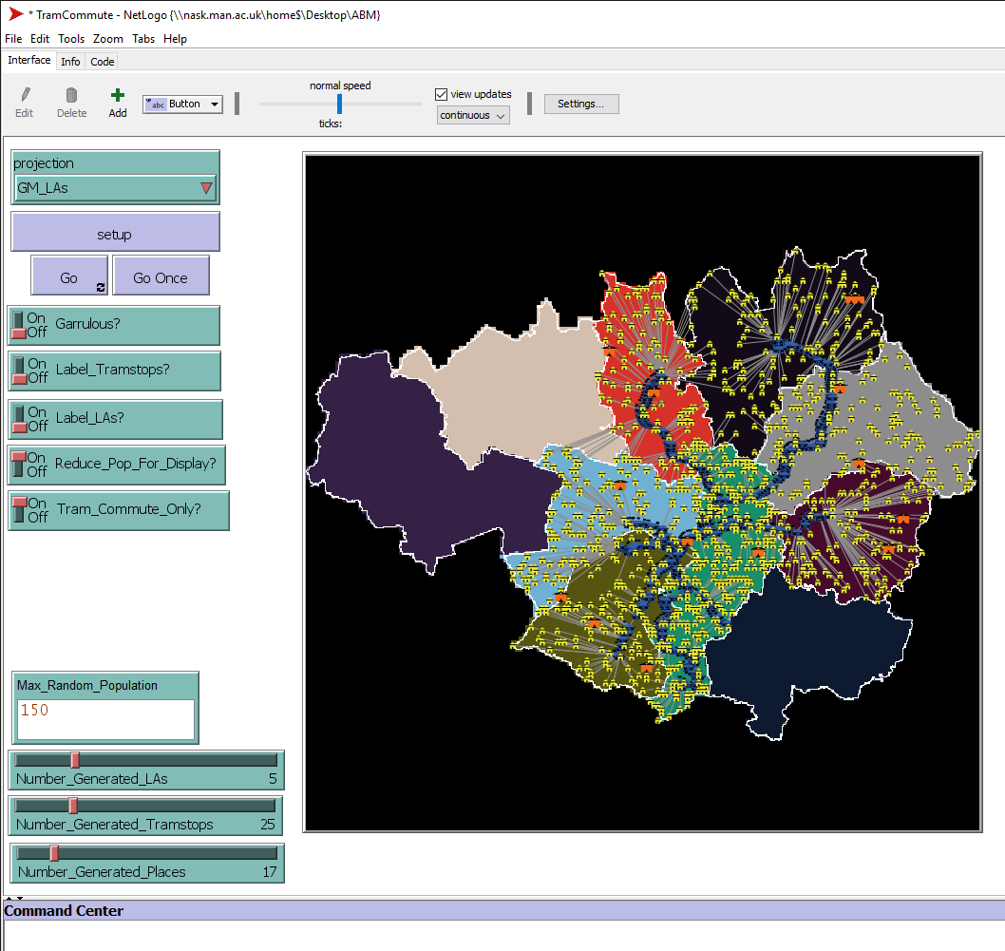
Import Greater Manchester Shapefiles
Notes:
Then, the houses and places are filled in.
As before, the houses are yellow and the places that commuters might go are orange. This is mostly just to make them a bit more visually distinct, which is more important here than in the randomly generated model because the scale is different.
There are also two switches I added to make this model easier to look at and faster run for demonstration purposes.
CLICK
First, “Reduce Population for Display” reduces the number of residents by 1000. If I did not, then you would not be able to see the tramlines for the number of houses.
CLICK
Second, “Tram_Commute_Only” means that no houses or places of interest are located in local authorities that have no tram stops.
This is a visual choice ,but it also prevents commuters from travelling in completely nonsensical ways to get to or from a tram stop. In reality, if there are no nearby tram stops, you probably would just not travel by tram. You would do something else. If you were to run experiments with this model, you would certainly want to set “Reduce Population for Display” to OFF so that you test it properly with the real population numbers. But you may or may not want to set “Tram Commute Only” to OFF. It depends on whether you are really only looking at commuters that could reasonably be expected to use trams or at what would happen if trams were the only commuting option. That all depends on your research question.

Slide 32
What can I do with this?
Use different boundaries?
Use data to guide behaviour data?
Add average income/education level/health indicators/etc. data to residences?
Community interaction?
Add other ways to travel?
Create relevant output?
Notes:
You might think, “Well, it looks neat. But what can I really do with this?”
CLICK
You can use different boundaries. Different places of course, like London or Liverpool. Alternatively, you could use the same place but different boundaries. If you choose much smaller polygons, like wards or small output areas, you can really drill down to see what the populations are like that are properly within walking distance of a tram stop.
CLICK
You can use different data. At the moment, commuters just sort of pick a selection of places to travel to but could have used the UKDS “travel to work” data which tells you how many people from each area travel to each other area. That would make commuter journeys across the network more realistic or representative, although it would not tell you about chained journeys where people go do things before or after work or about the travel people do that is not associated with going to the same work location every day.
CLICK
You can add lots more features to the polygons. I only added population but you could add social metrics, political metrics, air quality metrics, local property price metrics. So many options here!
CLICK
Travel is obviously a feature of commuters and that is what I had in mind when I tested this model. But may you want to test other kinds of travel. For example, you might want to explore why some communities because isolated while others are very open, or the influence of transport access on the development and maintenance of regional dialects, or whether transport structure helps or hinders a city’s ability to maintain thriving minority ethnic, artistic or LGBT+ communities.
CLICK
You might choose not to filter out the rail stations. Alternatively, you could add roads, buses, bike lanes, pedestrian paths, rideshares and taxis, or many more.
CLICK
I haven’t really addressed output in this webinar, because I cover it in the next one on February 13th. But any changes you might make to a model should be relevant to your research question. For output, this might mean asking commuters to report how long they travel, how much money their commute costs, how crowded the tram carriages are. These kinds of output can inform research questions around why proximity to a tram stop is linked to different health outcomes, employment levels, educational attainment levels, business tax rates, disability accessible buildings and many more things.

Slide 33
Summary
There are lots of verified, functional, documented models to explore
Random generated models are very useful for testing
Check the model logic quickly
Rapid build-test cycles
Test code and data separately
Get sample output to check the format
Etc.
There is a wealth of real-world GIS, census and other data to use.
Real-world data needs a few steps to acquire, clean, combine, etc.
Actually importing the real-world data into NetLogo models is easy
Notes:
Just to summarise today’s topics.
CLICK
There are LOTS of models to explore in the models library. These can show you how researchers have created models to address research questions or how you can resolve specific code challenges.
CLICK
Building a randomly generated models is useful, even if you really want to use real-world data in your model because:
CLICK
You can get the model up and running quickly to sort of force yourself to think through your understanding.
You can really quickly develop your ideas and test them out without going through the process of downloading and preparing real-world data.
Also, making sure your model works with synthetic data allows you to test the model code as separate from the data. If you try to test it all at once and it doesn’t work, it can be hard to know where the problem is.
You can also test the output and do some preliminary analysis that can serve as a null hypothesis.
Among many other reasons too.
CLICK
There is a wealth of real-world data that can usefully be imported into NetLogo Models. This is only one example of how to import a couple of specific kinds of data, but there are many other ways to get real-world data in that you may want too. For example, you can get NetLogo models to read in text files, .CSV files and many other file types, depending on what your model is designed to explore.
CLICK
Downloading, preparing and combining real-world data is a process. This may actually be one of the more difficult steps.
CLICK
But actually importing that data is fairly easy. My code was only 36 lines long.

Slide 34


Dr. J. Kasmire
julia.kasmire@manchester.ac.uk
@JKasmireComplex
ukdataservice.ac.uk/help/
Subscribe to UK Data Service news at https://www.jiscmail.ac.uk
@UKDataService
UKDataService

